Slide 1

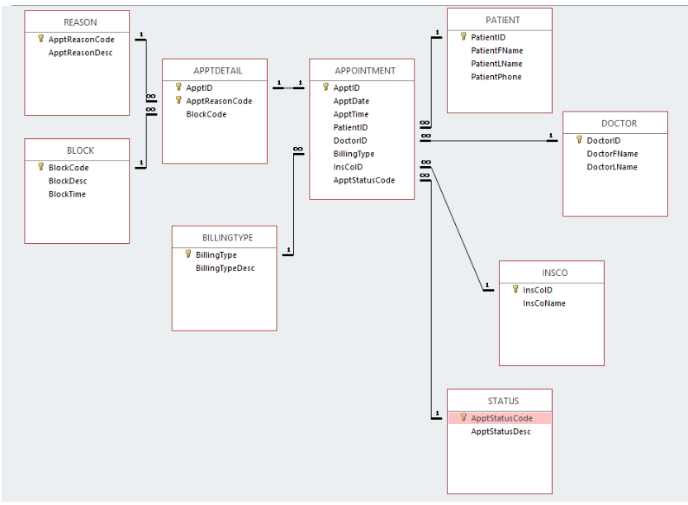
SQL HACKATHON
CHALLENGES & LEARNINGS

Slide 2

OUR TEAM
Shunmugpriya Veerapandian
Kalyani Kajjam
Nagjyothi Mukkara
Amita Avasthi
Dhanshri Patel

Slide 3
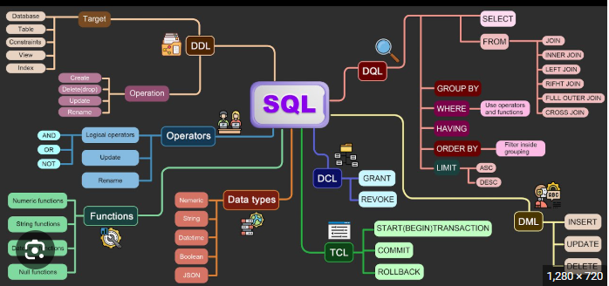
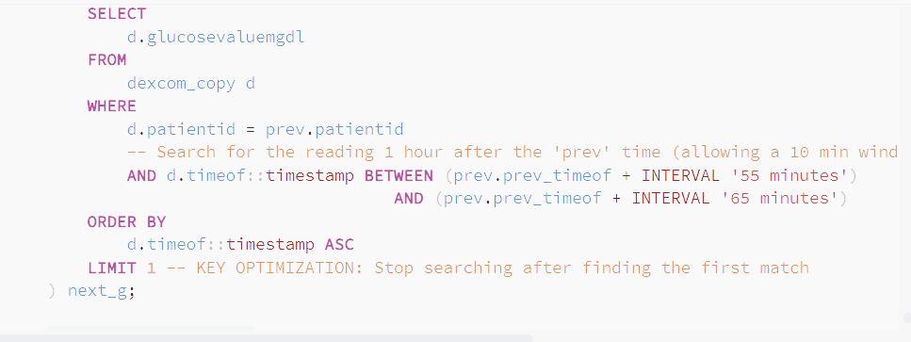
CHALLENGE 1: DATA INTEGRITY💪
Detecting and Removing Duplicate Records Challenge: Some wearables recorded multiple entries for the same timestamp due to device sync issues.
Action: Used SQL window functions to identify and remove duplicates.
Referential Integrity Between Tables Challenge: Ensuring that every glucose or EDA record had a valid corresponding patient in the Demography table.
Action: Enforced foreign key relationships or validated manually.
Handling Missing or Null Values Challenge: Incomplete data due to device disconnection or user non-compliance.
Action: Identified and imputed or excluded missing values based on the context.

Slide 4
CHALLENGE 2: DATA QUALITY💪
Defining Complex Cohorts Challenge: Needed patient groups with valid data across multiple sensors simultaneously.
Action: Used UNION and INTERSECT to define clean patient cohorts for combined HR and IBI studies.
Calculating Time-Based Gaps Challenge: Measuring the duration between sequential events (e.g., from spike to recovery)..
Action: Used DATE/TIME Ops (INTERVAL, EXTRACT) for precise event windowing and gap calculation.

Slide 5
CHALLENGE 3: Complex Queries💪
Sequential Pattern Tracking Challenge: Modeling events that happen in a chain (e.g., EDA rising over 3 consecutive readings)
Action: Implemented RECURSIVE CTEs to track complex escalating physiological sequences over time.
High-Performance Lookups Challenge: Finding the exact moment a patient recovered after a low Glucose event.
Action: Solved the Glucose Recovery Time problem using the highly efficient CROSS JOIN LATERAL with LIMIT 1.
Advanced Patient Ranking Challenge: Converting rows of raw data into clinical, human-readable columns (pivot tables).
Action: Used CROSSTAB to transform data into reports comparing Glucose levels across Morning/Night time blocks.
Continue …

Slide 6
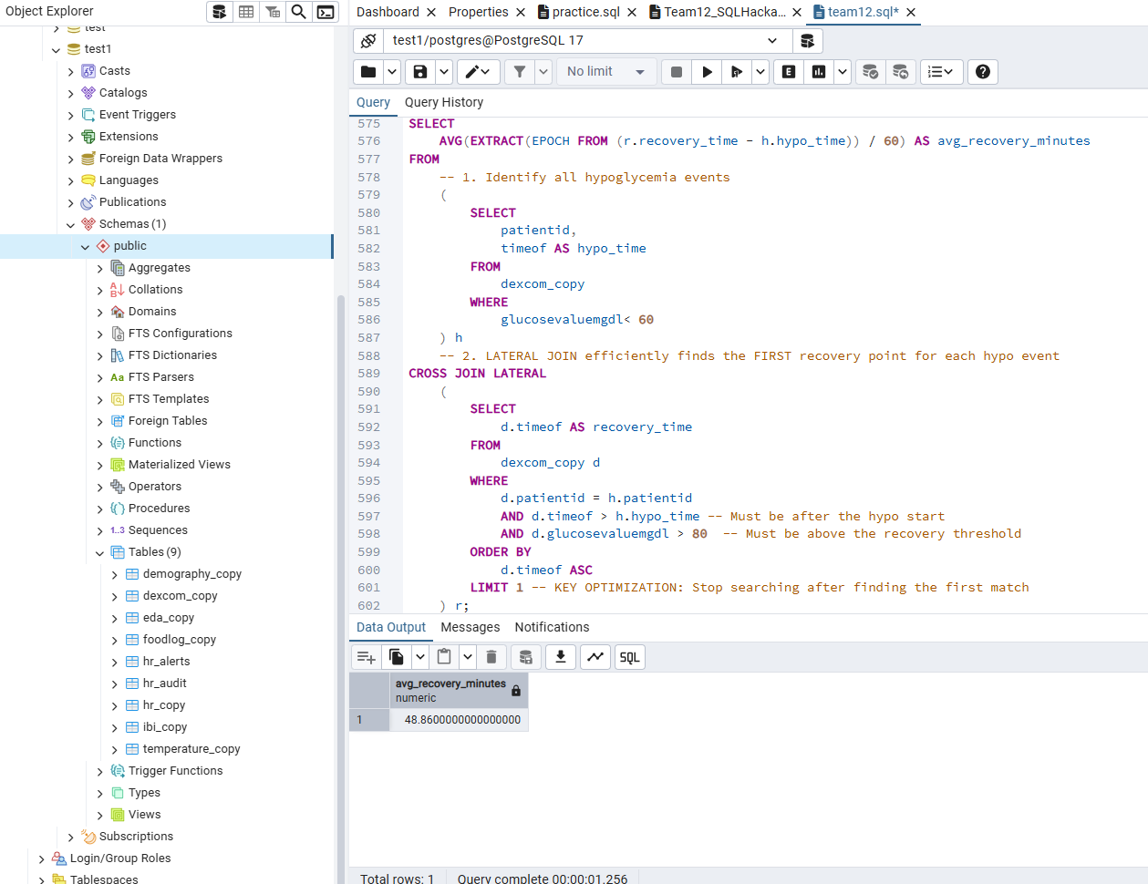
CHALLENGE 3: Complex Queries💪
Example of Complex Query – High Performance Lookup

Slide 7
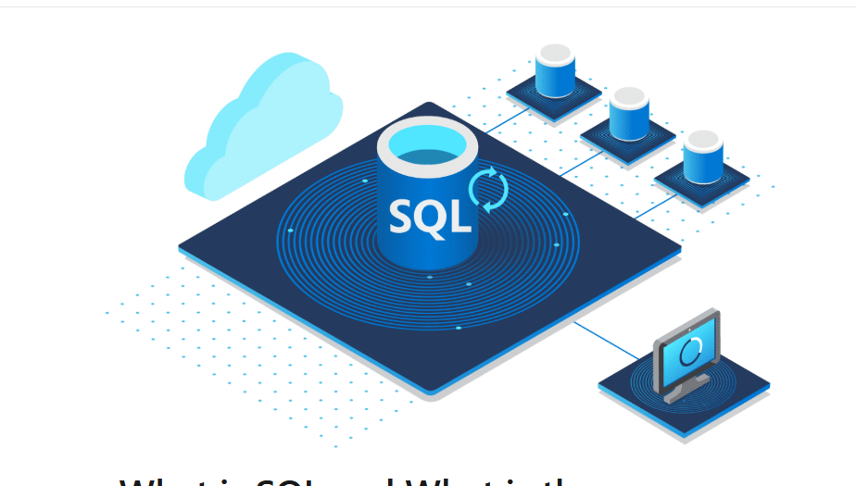
LEARNING
We gained significant confidence and learned advanced techniques within the PostgreSQL
The challenge of cleaning and integrating asynchronous data taught us essential problem-solving techniques and significantly strengthened our foundational SQL skills.
Replaced subqueries with faster Window Functions and enforced early data filtering to reduce the load on aggregations.
Used CTEs (Common Table Expressions) to break down complex queries into manageable, reusable steps for easier debugging.

Slide 8
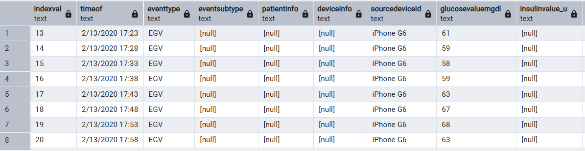
THANK'S FOR WATCHING

